Slide 1
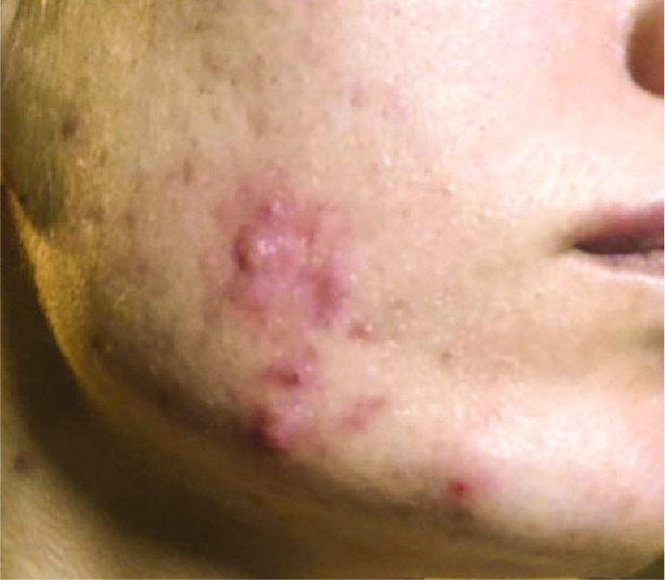
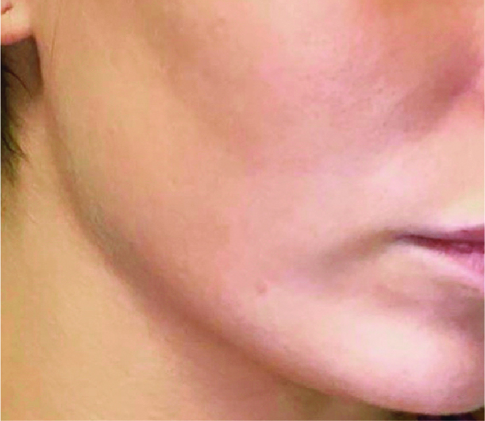
BEFORE / AFTER | 3 months post 8 tx | courtesy of Stephen T. Greenberg, MD
Forever Clear BBL®
420 nm Filter, 5 J/cm², 200 ms, 15 ˚C Cooling, 3 Passes, Large Adapter (15 x 45)
560 nm Filter, 15 J/cm², 20 ms, 15 ˚C Cooling, 2 Passes, Small Adapter (15 x 15)
590ST Filter, 10 J/cm², 10 s, 15 ˚C Cooling, 9 Passes
1
©2020 Sciton, Inc. All rights reserved. 2600-048-48 Rev. A B&A FCBBL

